Slide 1
Building Better Bricks: Module design and development best practices.

Slide 2
Chris Gardner
DevOps and ALM consultant at Black Marble
4+ Years PowerShell experience
Spent the last year+ automating software builds and writing DSC
Contribute to various DSC resources and maintain 1 of my own
Usually found on Slack (PSUGUK and PowerShell)
https://www.github.com/ChrisLGardner

Slide 3
Agenda
Why?
Module Structure options
Development Process
Function Design
Build Scripts

Slide 4
Why?

Slide 5
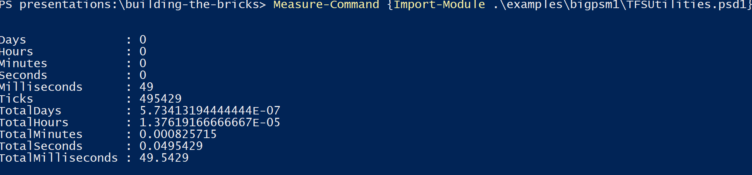
Module Structure – Big psm1

Slide 6
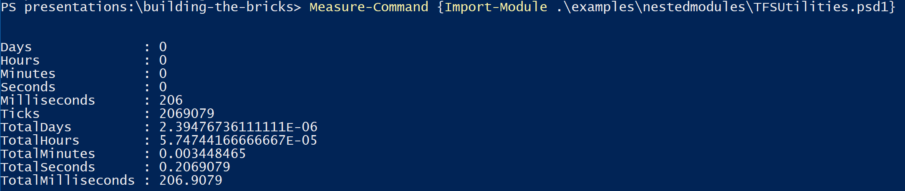
Module Structure – Nested Modules

Slide 7
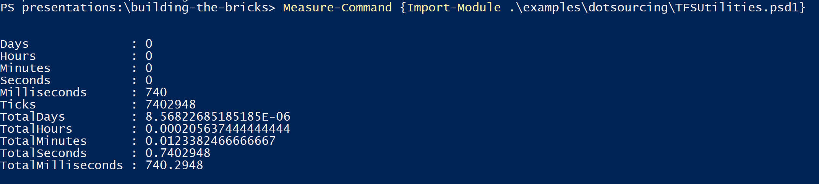
Module Structure – Dot sourced ps1

Slide 8
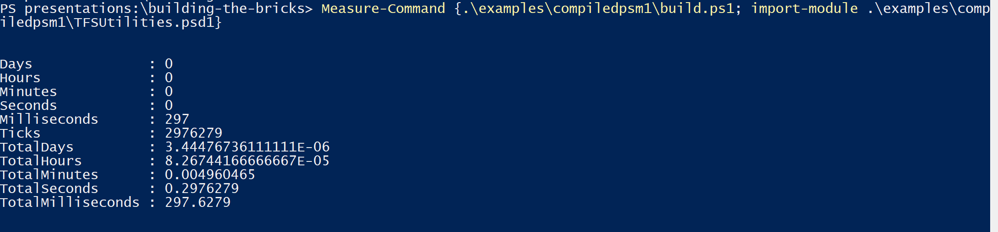
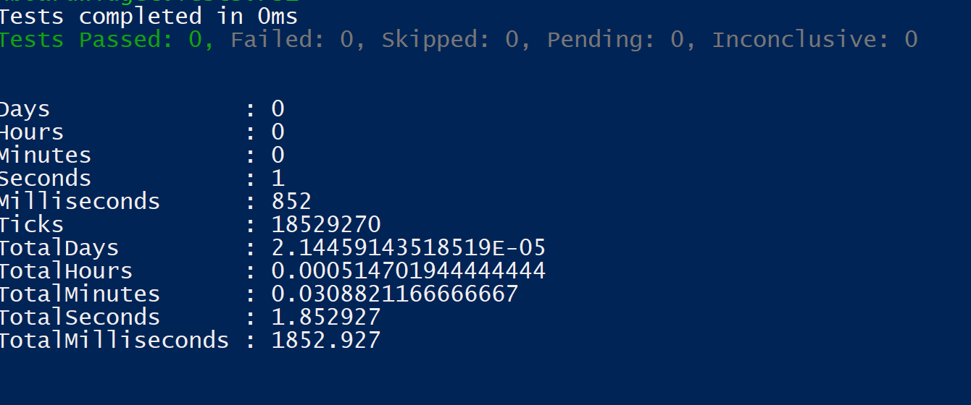
Module Structure – Compiled psm1

Slide 9
Development Process

Slide 10
Function Design

Slide 11
Build Scripts

Slide 12
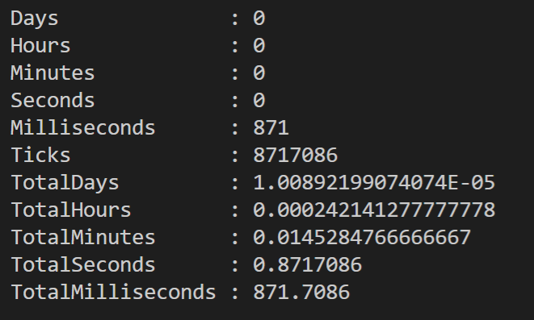

Slide 13
Questions?

Slide 14


Chris Gardner
@halbaradkenafin
Chrislgardner.github.io
github.com/chrislgardner
Contact Details

